Slide 1

Fruity WiFi: Wireless Network Auditing Tool
Dr. John W. Carls, CISSP, C|EH

Slide 2
OUtline
About
Overview
Install
Modules
Services
Demo

Slide 3
About
FruityWiFi is a wireless network auditing tool based on the WiFi Pineapple.
The application can be installed in any Debian-based system adding the extra packages.
Tested in Debian, Kali Linux, Kali Linux ARM (Raspberry Pi), Raspbian (Raspberry Pi), NetHunter.
http://fruitywifi.com/index_eng.html

Slide 4
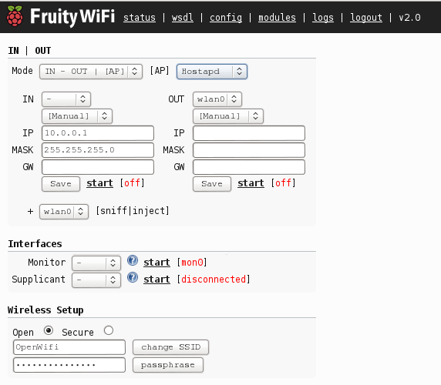
Overview
FruityWifi is an open source tool to audit wireless networks. It allows the user to deploy advanced attacks by directly using the web interface or by sending messages to it.
Initially the application was created to be used with the Raspberry-Pi, but it can be installed on any Debian based system.
FruityWifi v2.0 has many upgrades. A new interface, new modules, Realtek chipsets support, Mobile Broadband (3G/4G) support, a new control panel, and more.

Slide 5
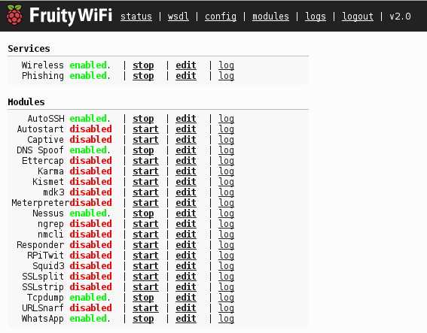
Overview (Cont’d)
A more flexible control panel. Now it is possible to use FruityWifi combining multiple networks and setups:
Ethernet -to- Ethernet
Ethernet -to- 3G/4G
Ethernet -to- Wifi
Wifi -to- Wifi
Wifi -to- 3G/4G, etc.
Within the new options on the control panel we can change the AP mode between Hostapd or Airmon-ng allowing to use more chipsets like Realtek.
It is possible customize each one of the network interfaces which allows the user to keep the current setup or change it completely.

Slide 6
Installation
Using the installation script all the required dependencies, scripts and setup can be installed.
On Jessie based systems use: install-FruityWifi-PHP5.sh
On Stretch based systems use: install-FruityWifi-PHP7.sh
x86/x64 Version
You need Debian (or based) installed (or a Live CD version) to use this script.
Download the zip file from https://github.com/xtr4nge/FruityWifi/archive/master.zip
Unzip the file and run install-FruityWifi-{PHPVersion}.sh (This script will install all the dependencies and setups)
Go to http://localhost:8000 (for http)
Go to https://localhost:8443 (for https)
user: admin
pass: admin

Slide 7
Installation (linux)
Kali Linux Version
FruityWifi is now part of Kali Linux repositories.
apt-get install fruitywifi
/etc/init.d/fruitywifi start
/etc/init.d/php5-fpm start
Go to http://localhost:8000 (for http)
Go to https://localhost:8443 (for https)
user: admin
pass: admin
Note: installing fruitywifi will install all modules. If you want to install only some modules, you can install fruitywifi-core first and then each module, for example fruitywifi-module-dnsspoof.

Slide 8
Installation (ARM)
ARM version (Raspberry Pi)
You need a Raspbian, Pwnpi or Kali Linux version to use this script.
Download the zip file from https://github.com/xtr4nge/FruityWifi/archive/master.zip
Unzip the file and run install-FruityWifi-{PHPVersion}.sh
(This script will install all the dependencies and setups)
Go to http://localhost:8000 (for http)
Go to https://localhost:8443 (for https)
user: admin
pass: admin

Slide 9
Important Note (Debian Buster)
Please use Use Debian Buster based systems. The Installer has been updated for resolving issues with old version.
FruityWiFi is an open source tool to audit wireless networks. It allows the user to deploy advanced attacks by directly using the web interface or by sending messages to it.
Initialy the application was created to be used with the Raspberry-Pi, but it can be installed on any Debian based system.

Slide 10
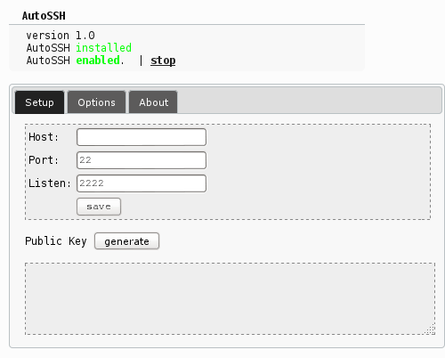
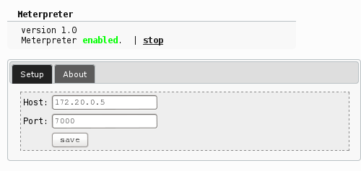
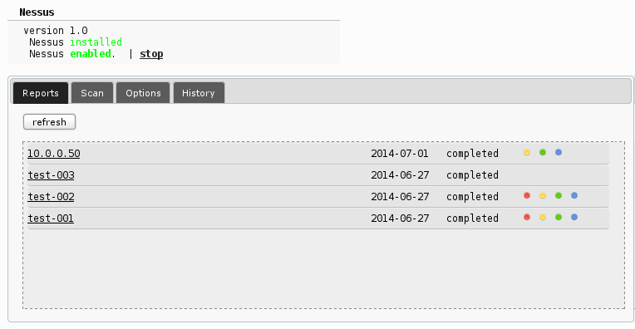
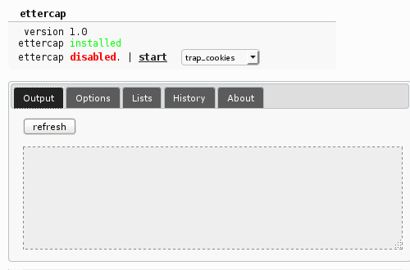
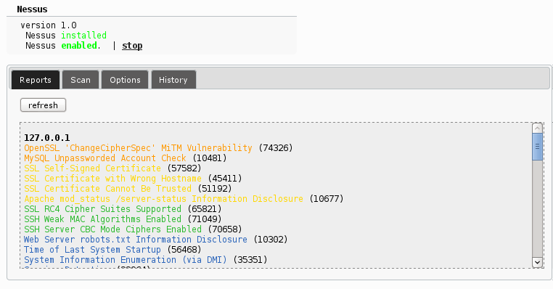
Modules
FruityWifi is based on modules making it more flexible. These modules can be installed from the control panel to provide FruityWifi with new functionalities.
Within the available modules you can find:
URLsnarf
DNSspoof
Kismet
Mdk3
Ngrep
Nmap
Squid3
SSLstrip (code injection functionality)
Captive Portal
AutoSSH
Meterpreter
Tcpdump
and more.

Slide 11
Services
Wireless: Start|Stop wireless access point. (hostapd)
Supplicant: Connects to the internet using a wireless interface
Karma: REF: http://www.digininja.org/karma/
URL Snarf: Start|Stop urlsnarf
DNS Spoof: Start|Stop dnsspoof
Kismet: Start|Stop kismet
Squid: Start|Stop squid3
sslstrip: Start|Stop sslstrip

Slide 12
Logs
Log files for
URLSNARF
URLSPOOF
DNSMASQ
Others

Slide 13
DEMO
https://youtu.be/rDB0njXQgjI
https://youtu.be/FkQw-_Wlpa0

